Slide 1
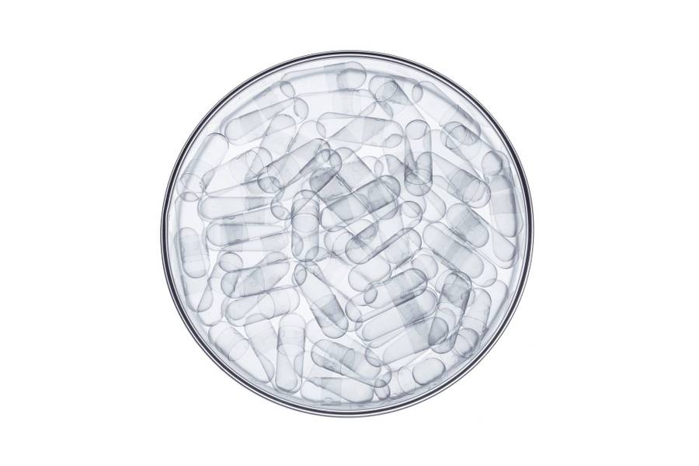
Spontaneous Synchronization in Cellular Circadian Clocks
Yuelong Li

Slide 2
Sections
Single cell model
Single cell simulation
Multi cell model & simulation
Mean flow theory
Phenomenological theory
Conclusions

Slide 3
Single Cell Model

Slide 4




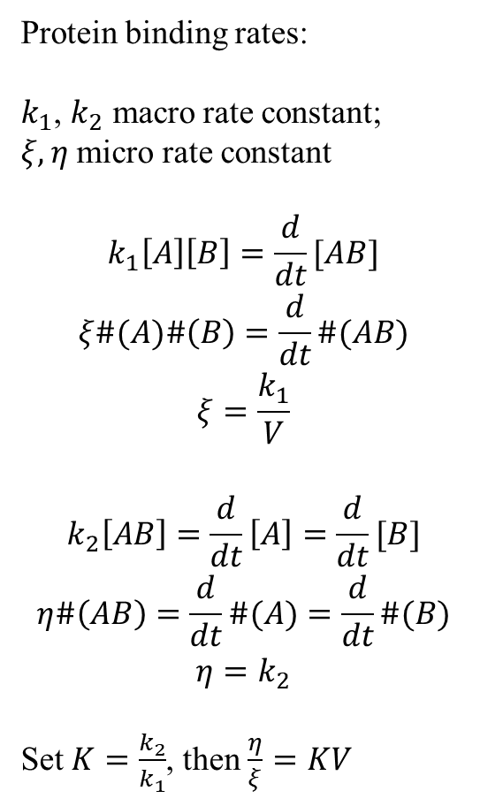








Single Cell Model
Protein binding rates:
$k_{1}$, $k_{2}$ macro rate constant;
$ξ, η$ micro rate constant
$$k_{1}\left[A\right]\left[B\right]=\frac{d}{dt}[AB]$$
$$ξ\#(A)\#\left(B\right)=\frac{d}{dt}\#(AB)$$
$$ξ=\frac{k_{1}}{V}$$
$$k_{2}\left[AB\right]=\frac{d}{dt}\left[A\right]=\frac{d}{dt}[B]$$
$$η\#\left(AB\right)=\frac{d}{dt}\#(A)=\frac{d}{dt}\#(B)$$
$$η=k_{2}$$
Set $K=\frac{k_{2}}{k_{1}}$, then $\frac{η}{ξ}=KV$
Nucleus
Cytoplasm
$$αp_{0}$$
$$γ_{n}$$
$$m_{n}$$
$$m_{c}$$
$$ξ$$
$$δ_{m}$$
$$η$$
$$δ_{p}$$
$$γ_{p}$$
$$p_{n}$$
$$p_{c}$$
$$β$$

Slide 5
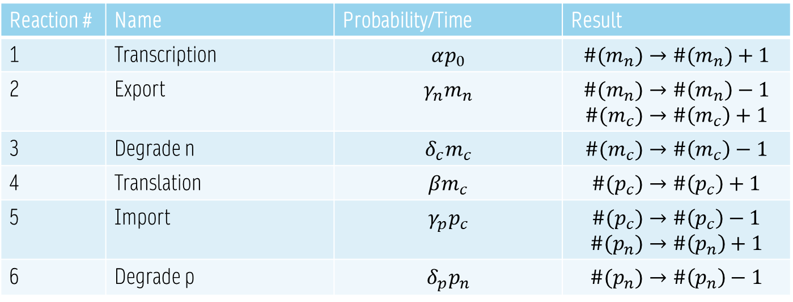
Reaction Table
Reaction # | Name | Probability/Time | Result
1 | Transcription | $$αp_{0}$$ | $$\#(m_{n})→\#(m_{n})+1$$
2 | Export | $$γ_{n}m_{n}$$ | $$\#(m_{n})→\#\left(m_{n}\right)−1$$ $$\#(m_{c})→\#\left(m_{c}\right)+1$$
3 | Degrade n | $$δ_{c}m_{c}$$ | $$\#(m_{c})→\#\left(m_{c}\right)−1$$
4 | Translation | $$βm_{c}$$ | $$\#(p_{c})→\#\left(p_{c}\right)+1$$
5 | Import | $$γ_{p}p_{c}$$ | $$\#(p_{c})→\#\left(p_{c}\right)−1$$ $$\#(p_{n})→\#\left(p_{n}\right)+1$$
6 | Degrade p | $$δ_{p}p_{n}$$ | $$\#(p_{n})→\#\left(p_{n}\right)−1$$

Slide 6
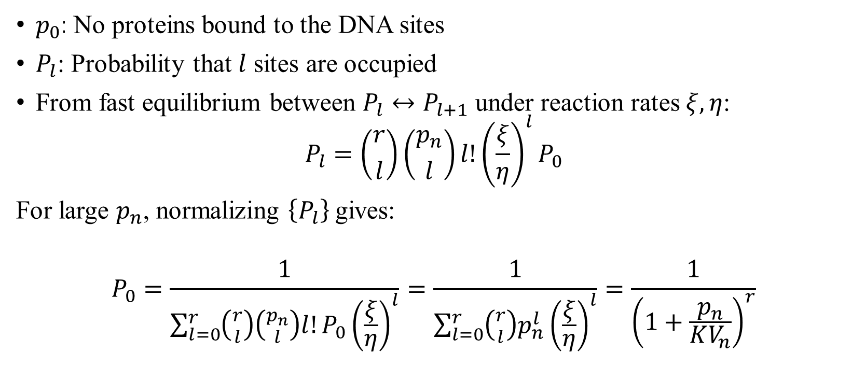
Protein Binding
$p_{0}$: No proteins bound to the DNA sites
$P_{l}$: Probability that $l$ sites are occupied
From fast equilibrium between $P_{l}↔P_{l+1}$ under reaction rates $ξ,η$:
$$P_{l}=\left({r \atop l}\right)\left({p_{n} \atop l}\right)l!{\left(\frac{ξ}{η}\right)}^{l}P_{0}$$
For large $p_{n}$, normalizing $\left\{P_{l}\right\}$gives:
$$P_{0}=\frac{1}{\sum_{l=0}^{r}{\left({r \atop l}\right)\left({p_{n} \atop l}\right)l!P_{0}{\left(\frac{ξ}{η}\right)}^{l}}}=\frac{1}{\sum_{l=0}^{r}{\left({r \atop l}\right)p_{n}^{l}{\left(\frac{ξ}{η}\right)}^{l}}}=\frac{1}{{\left(1+\frac{p_{n}}{KV_{n}}\right)}^{r}}$$

Slide 7



Continuous Time Model
From continuous perspective,
$\frac{d}{dt}\#\left(species\right)=$ Probability of [$\#\left(specie\right)+1$] per unit time
Then # of four species:
$$\frac{dm_{n}}{dt}=α{\left(\frac{K}{K+\frac{p_{n}}{V}}\right)}^{r}−γ_{m}m_{n}$$
$$\frac{dm_{c}}{dt}=γ_{m}m_{n}−δ_{m}m_{c}$$
$$\frac{dp_{c}}{dt}=βm_{c}−γ_{p}p_{c}$$
$$\frac{dp_{n}}{dt}=γ_{p}p_{c}−δ_{p}p_{n}$$
$$(r≥5)$$

Slide 8
Single Cell Simulation

Slide 9


Continuous Time Model
Solve with RK4 method:
Need parameters: $α,β,K,V,γ_{m},δ_{m},γ_{p},δ_{p}$
Initial Conditions: $m_{n}^{0}=10.9, m_{c}^{0}=1.88$, $p_{n}^{0}=500$, $p_{c}^{0}=\frac{p_{n0}}{2}=250$.
$$\frac{dm_{n}}{dt}=α{\left(\frac{K}{K+\frac{p_{n}}{V}}\right)}^{r}−γ_{m}m_{n}$$
$$\frac{dm_{c}}{dt}=γ_{m}m_{n}−δ_{m}m_{c}$$
$$\frac{dp_{c}}{dt}=βm_{c}−γ_{p}p_{c}$$
$$\frac{dp_{n}}{dt}=γ_{p}p_{c}−δ_{p}p_{n}$$

Slide 10
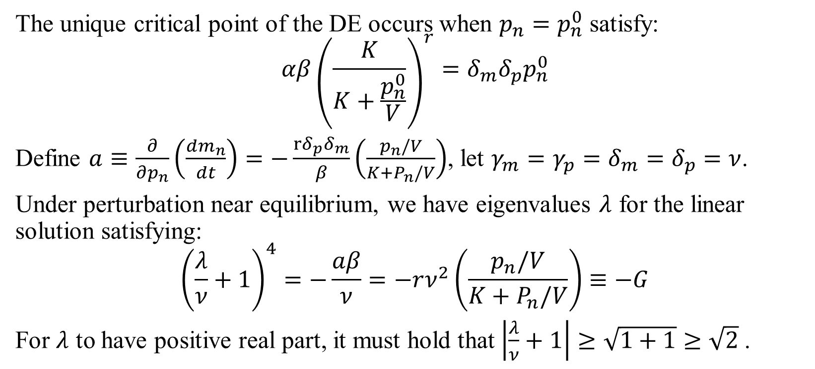
Parameter Design-K
The unique critical point of the DE occurs when $p_{n}=p_{n}^{0}$ satisfy:
$$αβ{\left(\frac{K}{K+\frac{p_{n}^{0}}{V}}\right)}^{r}=δ_{m}δ_{p}p_{n}^{0}$$
Define $a≡\frac{∂}{∂p_{n}}\left(\frac{dm_{n}}{dt}\right)=−\frac{rδ_{p}δ_{m}}{β}\left(\frac{p_{n}/V}{K+P_{n}/V}\right)$, let $γ_{m}=γ_{p}=δ_{m}=δ_{p}=ν$.
Under perturbation near equilibrium, we have eigenvalues $λ$ for the linear solution satisfying:
$${\left(\frac{λ}{ν}+1\right)}^{4}=−\frac{aβ}{ν}=−rν^{2}\left(\frac{p_{n}/V}{K+P_{n}/V}\right)≡−G$$
For $λ$ to have positive real part, it must hold that $\left|\frac{λ}{ν}+1\right|≥\sqrt{1+1}≥\sqrt{2}$.

Slide 11
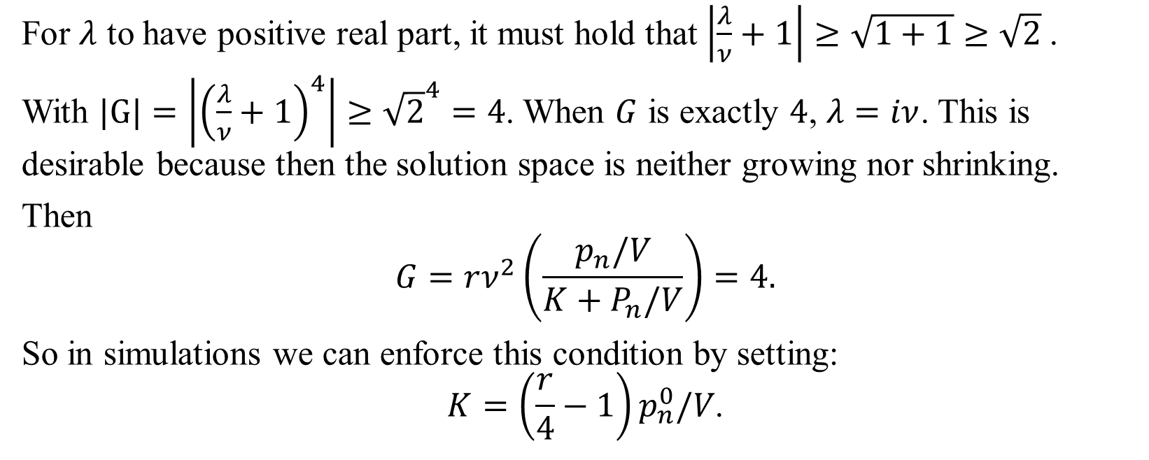
Parameter Design-K
For $λ$ to have positive real part, it must hold that $\left|\frac{λ}{ν}+1\right|≥\sqrt{1+1}≥\sqrt{2}$.
With $|G|=\left|{\left(\frac{λ}{ν}+1\right)}^{4}\right|≥{\sqrt{2}}^{4}=4$. When $G$ is exactly $4$, $λ=iν$. This is desirable because then the solution space is neither growing nor shrinking.
Then
$$G=rν^{2}\left(\frac{p_{n}/V}{K+P_{n}/V}\right)=4.$$
So in simulations we can enforce this condition by setting:
$$K=\left(\frac{r}{4}−1\right)p_{n}^{0}/V\text{.}$$

Slide 12
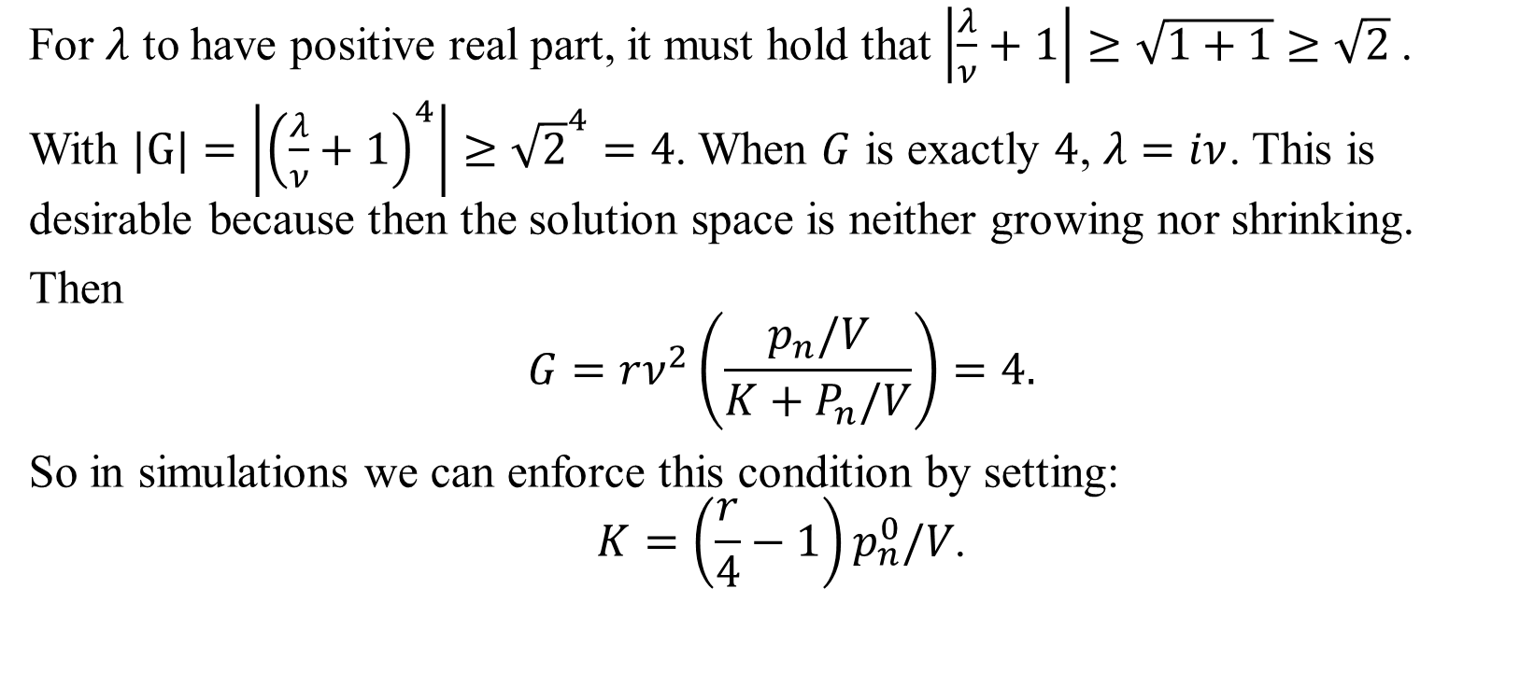
Parameter Design-K
For $λ$ to have positive real part, it must hold that $\left|\frac{λ}{ν}+1\right|≥\sqrt{1+1}≥\sqrt{2}$.
With $|G|=\left|{\left(\frac{λ}{ν}+1\right)}^{4}\right|≥{\sqrt{2}}^{4}=4$. When $G$ is exactly $4$, $λ=iν$. This is desirable because then the solution space is neither growing nor shrinking.
Then
$$G=rν^{2}\left(\frac{p_{n}/V}{K+P_{n}/V}\right)=4.$$
So in simulations we can enforce this condition by setting:
$$K=\left(\frac{r}{4}−1\right)p_{n}^{0}/V\text{.}$$

Slide 13
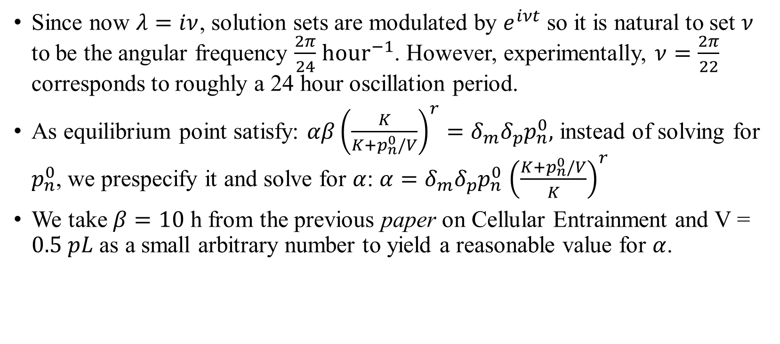

Parameter Design-$ν,α,β,V$
Since now $λ=iν$, solution sets are modulated by $e^{iνt}$ so it is natural to set $ν$ to be the angular frequency $\frac{2π}{24}$ $hour^{−1}$. However, experimentally, $ν=\frac{2π}{22}$ corresponds to roughly a 24 hour oscillation period.
As equilibrium point satisfy: $αβ{\left(\frac{K}{K+p_{n}^{0}/V}\right)}^{r}=δ_{m}δ_{p}p_{n}^{0},$ instead of solving for $p_{n}^{0}$, we prespecify it and solve for $α$: $α=δ_{m}δ_{p}p_{n}^{0}$ ${\left(\frac{K+p_{n}^{0}/V}{K}\right)}^{r}$
We take $β=10$ h from the previous paper on Cellular Entrainment and V = $0.5 pL$ as a small arbitrary number to yield a reasonable value for $α$.

Slide 14
Parameter Initialization
nu = 2*math.pi/22
gm = nu
dm = nu
gp = nu
dp = nu
r = 5
b = 10
V=0.1
pn0 = 500
K=(r/4-1)*pn0*V+1 => K = 13.5 => K = 63.5
a=dm*dp*pn0*((K+pn0/V)/K)**r/b #alpha => a = 5374068

Slide 15
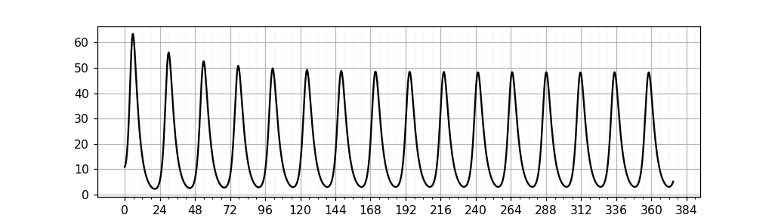
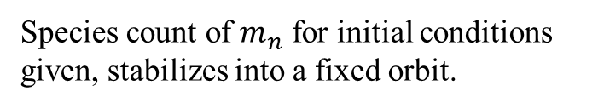
Simulation Result
Species count of $m_{n}$ for initial conditions given, stabilizes into a fixed orbit.

Slide 16
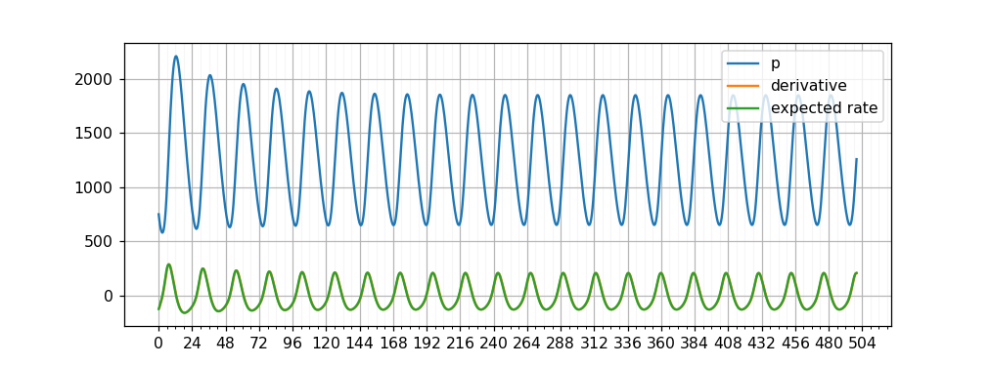
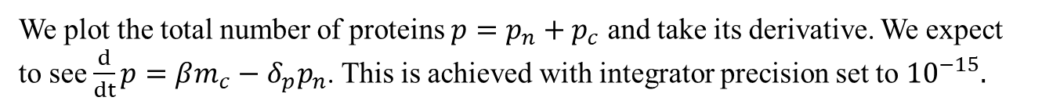
Validation
We plot the total number of proteins $p=p_{n}+p_{c}$ and take its derivative. We expect to see $\frac{d}{dt}p=βm_{c}−δ_{p}p_{n}$. This is achieved with integrator precision set to ${10}^{−15}.$
Total number of proteins (blue) and its derivative (orange, covered), which matches the expected rate of change (green).

Slide 17
Multi Cell Model

Slide 18

















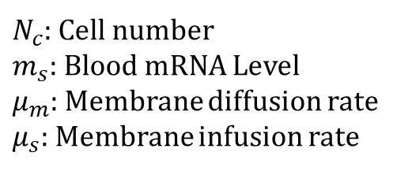













Multi Cell Model
$$m_{s}$$
Cell 1
Nucleus
Cytoplasm
Blood Stream
$$αp_{0}^{1}$$
$$γ_{n}$$
$$μ_{m}$$
$$m_{n}^{1}$$
$$m_{c}^{1}$$
$$ξ$$
$$μ_{s}$$
$$η$$
$$δ_{p}$$
$$γ_{p}$$
$$p_{n}^{1}$$
$$p_{c}^{1}$$
$$β$$
$${N_{c}δ}_{m}$$
Cell 2
Nucleus
Cytoplasm
$$αp_{0}^{2}$$
$$γ_{n}$$
$$μ_{m}$$
$$m_{n}^{2}$$
$$m_{c}^{2}$$
$$ξ$$
$$μ_{s}$$
$N_{c}$: Cell number
$m_{s}$: Blood mRNA Level
$μ_{m}$: Membrane diffusion rate
$μ_{s}$: Membrane infusion rate
$$η$$
$$δ_{p}$$
$$γ_{p}$$
$$p_{n}^{2}$$
$$p_{c}^{2}$$
$$β$$
…Cell $N_{c}$
$$…$$

Slide 19

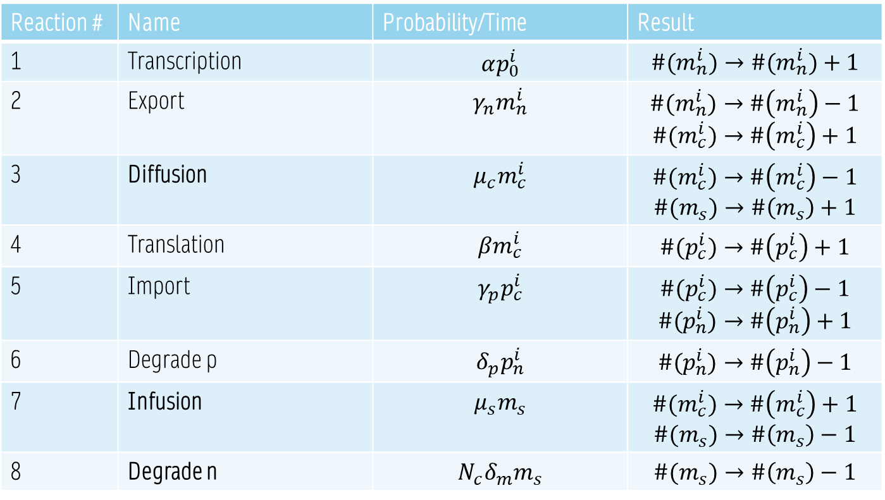
Reaction Table
Reaction # | Name | Probability/Time | Result
1 | Transcription | $$αp_{0}^{i}$$ | $$\#(m_{n}^{i})→\#(m_{n}^{i})+1$$
2 | Export | $$γ_{n}m_{n}^{i}$$ | $$\#(m_{n}^{i})→\#\left(m_{n}^{i}\right)−1$$ $$\#(m_{c}^{i})→\#\left(m_{c}^{i}\right)+1$$
3 | Diffusion | $$μ_{c}m_{c}^{i}$$ | $$\#(m_{c}^{i})→\#\left(m_{c}^{i}\right)−1$$ $$\#(m_{s})→\#\left(m_{s}\right)+1$$
4 | Translation | $$βm_{c}^{i}$$ | $$\#(p_{c}^{i})→\#\left(p_{c}^{i}\right)+1$$
5 | Import | $$γ_{p}p_{c}^{i}$$ | $$\#(p_{c}^{i})→\#\left(p_{c}^{i}\right)−1$$ $$\#(p_{n}^{i})→\#\left(p_{n}^{i}\right)+1$$
6 | Degrade p | $$δ_{p}p_{n}^{i}$$ | $$\#(p_{n}^{i})→\#\left(p_{n}^{i}\right)−1$$
7 | Infusion | $$μ_{s}m_{s}$$ | $$\#(m_{c}^{i})→\#\left(m_{c}^{i}\right)+1$$ $$\#(m_{s})→\#\left(m_{s}\right)−1$$
8 | Degrade n | $$N_{c}δ_{m}m_{s}$$ | $$\#(m_{s})→\#\left(m_{s}\right)−1$$
$$×N_{c}$$

Slide 20

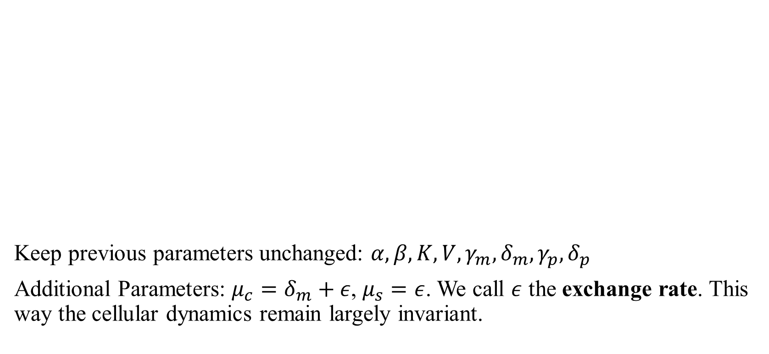
Continuous Time Model
$$\frac{dm_{n}^{i}}{dt}=α{\left(\frac{K}{K+p_{n}^{i}/V}\right)}^{r}−γ_{m}m_{n}^{i}$$
$$\frac{dm_{c}^{i}}{dt}=γ_{m}m_{n}^{i}−μ_{c}m_{c}^{i}+μ_{s}m_{s}$$
$$\frac{dp_{c}^{i}}{dt}=βm_{c}^{i}−γ_{p}p_{c}^{i}$$
$$\frac{dp_{n}^{i}}{dt}=γ_{p}p_{c}^{i}−δ_{p}p_{n}^{i}, i∈[N_{c}]$$
$$\frac{dm_{s}}{dt}=\sum_{i=1}^{N_{c}}{μ_{c}m_{c}^{i}}−N_{c}μ_{s}m_{s}−N_{c}δ_{m}m_{s}$$
Keep previous parameters unchanged: $α,β,K,V,γ_{m},δ_{m},γ_{p},δ_{p}$
Additional Parameters: $μ_{c}=δ_{m}+ε$, $μ_{s}=ε$. We call $ε$ the exchange rate. This way the cellular dynamics remain largely invariant.

Slide 21
Multi Cell Simulation

Slide 22
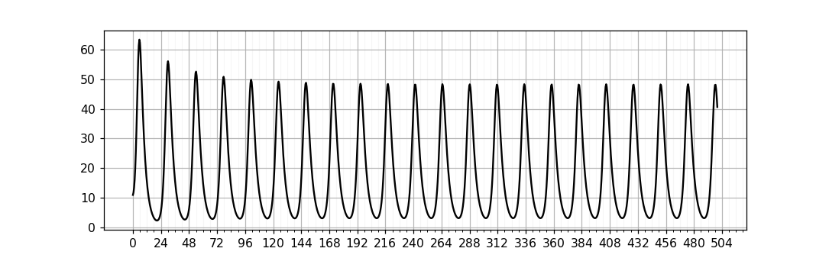
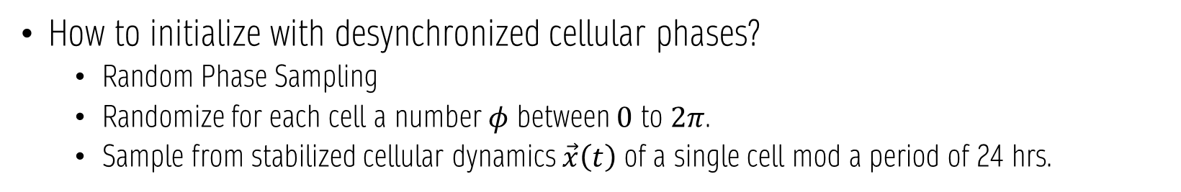
Initialization
How to initialize with desynchronized cellular phases?
Random Phase Sampling
Randomize for each cell a number $φ$ between $0$ to $2π$.
Sample from stabilized cellular dynamics $\vec{x}\left(t\right)$ of a single cell mod a period of 24 hrs.

Slide 23
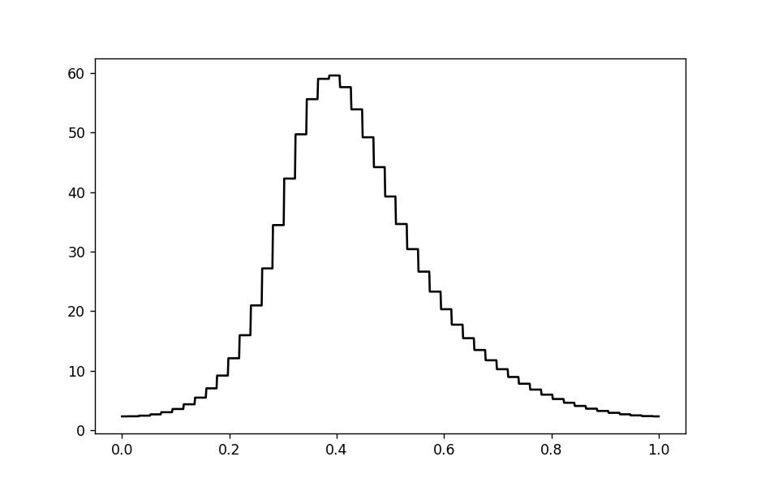
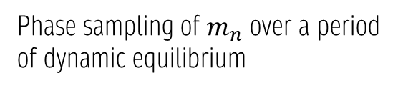
Phase sampling of $m_{n}$ over a period of dynamic equilibrium

Slide 24
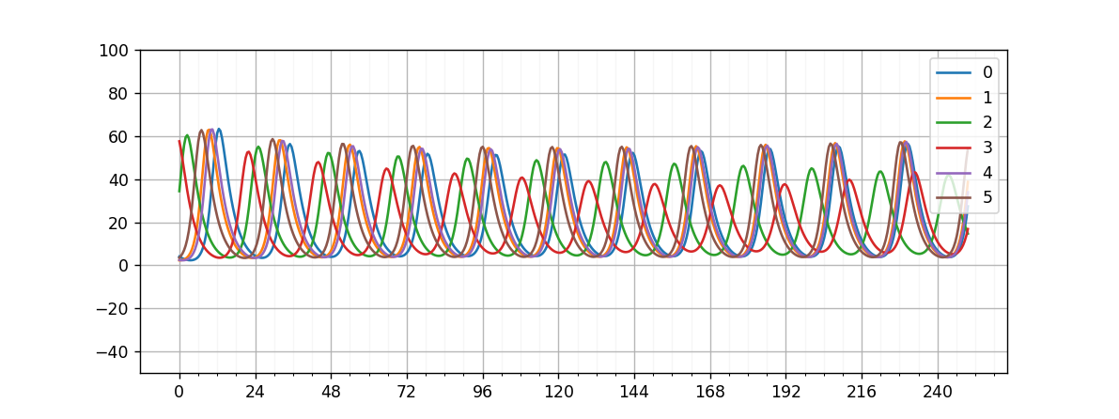
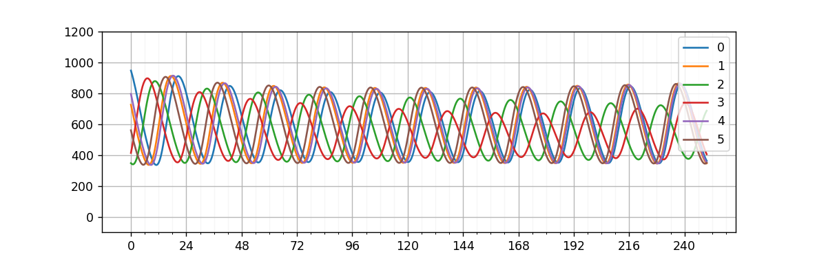

Simulation Result – 5 Cells
$m_{n}^{i}$ with randomized initial phases, $ε=\frac{2}{22},μ_{s}=1≠ε$
$p_{n}^{i}$ with randomized initial phases

Slide 25
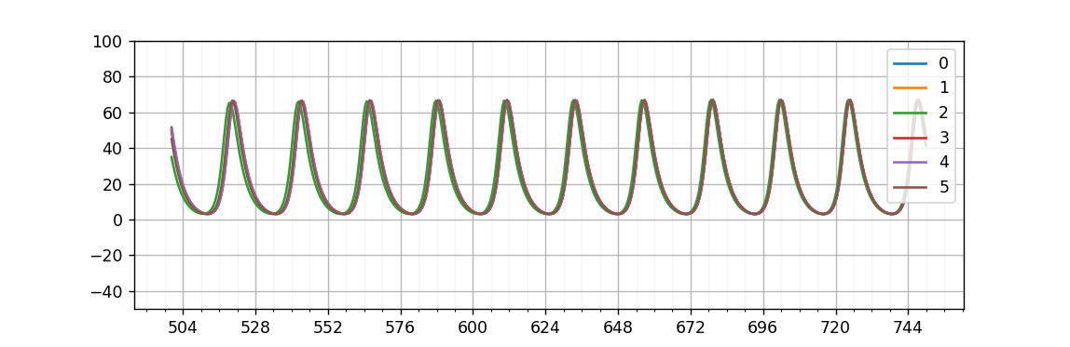
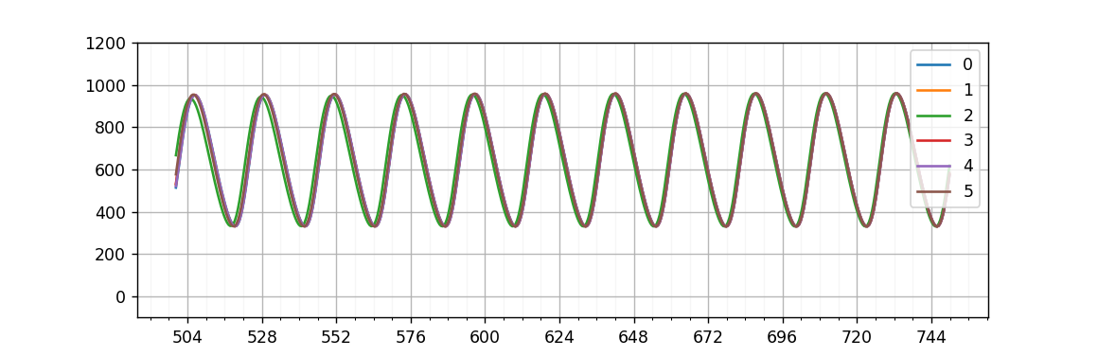

Simulation Result – 5 Cells
$m_{n}^{i}$ with randomized initial phases
$p_{n}^{i}$ with randomized initial phases

Slide 26
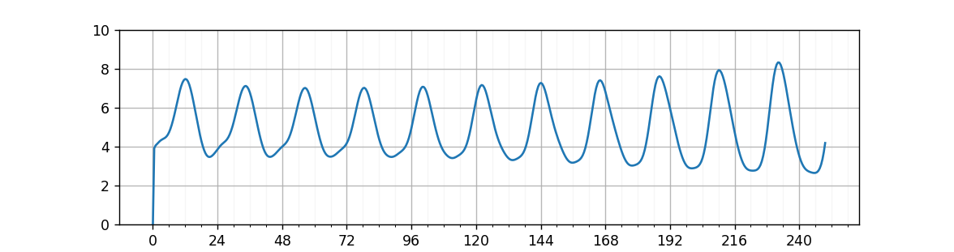
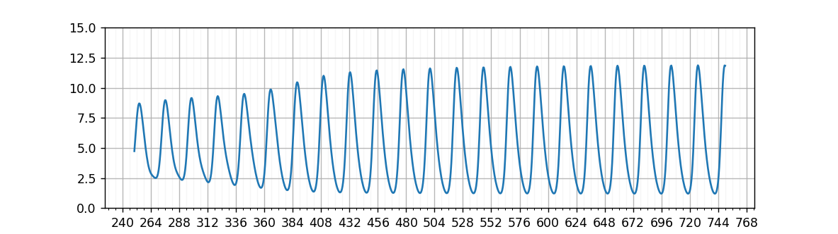

5 Cells – Blood mRNA
$$m_{s}, T 0\sim 250$$
$$m_{s}, T 250\sim 750$$

Slide 27
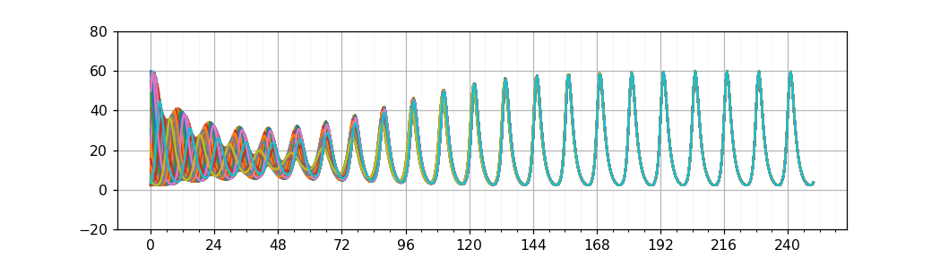
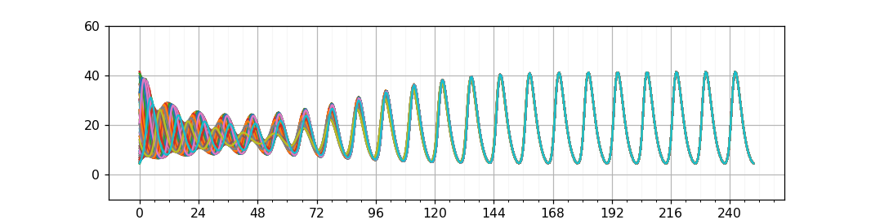
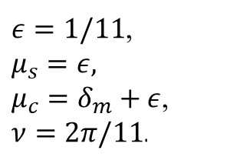

100 Cells – mRNA
$ε=1/11$,
$$μ_{s}=ε,$$
$μ_{c}=δ_{m}+ε$, $ν=2π/11$.
$$m_{n}^{i}$$
$$m_{c}^{i}$$

Slide 28
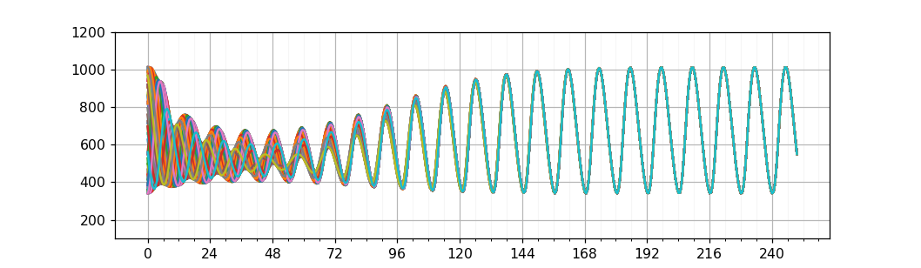
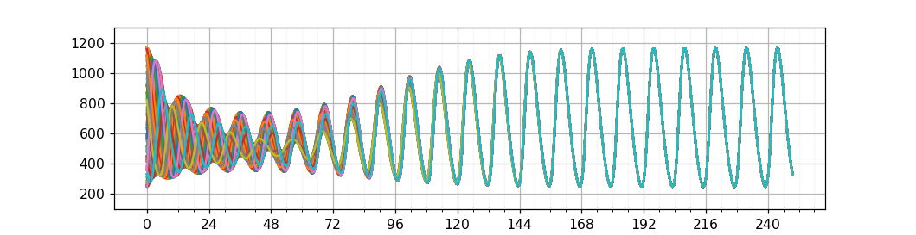


100 Cells – Protein
$$p_{n}^{i}$$
$$p_{c}^{i}$$

Slide 29
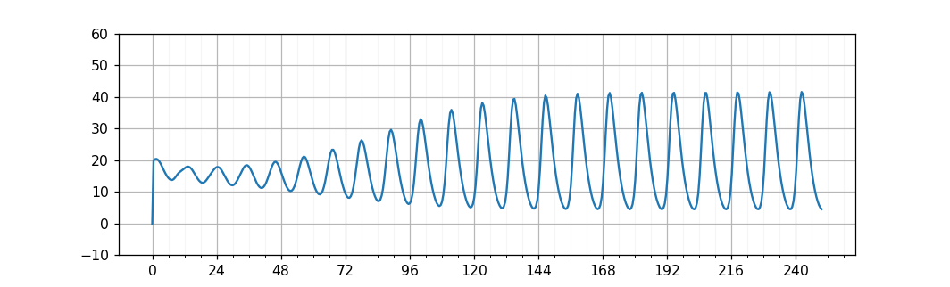
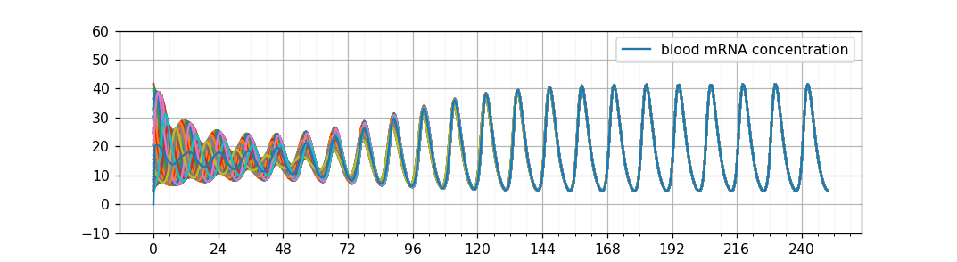


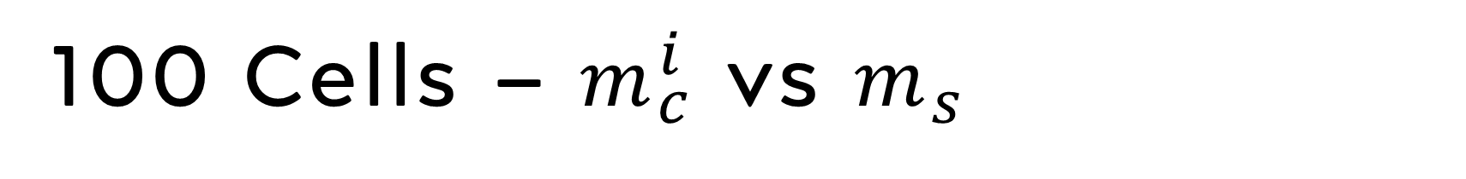
100 Cells – $m_{c}^{i}$ vs $m_{s}$
$m_{s}$, $ε=2/22$, $μ_{s}=ε,μ_{c}=δ_{m}+ε$
$m_{s}$ vs $m_{c}^{i}$

Slide 30
Mean Flow Theory

Slide 31




Mean Flow Theory
For $N_{c}≫1$: take
$$\frac{dm_{n}^{i}}{dt}=α{\left(\frac{K}{K+p_{n}^{i}/V}\right)}^{r}−γ_{m}m_{n}^{i}$$
$$\frac{dm_{c}^{i}}{dt}=γ_{m}m_{n}^{i}−μ_{c}m_{c}^{i}+μ_{s}m_{s}$$
$$\frac{dp_{c}^{i}}{dt}=βm_{c}^{i}−γ_{p}p_{c}^{i}$$
$$\frac{dp_{n}^{i}}{dt}=γ_{p}p_{c}^{i}−δ_{p}p_{n}^{i}, i∈[N_{c}]$$
$$\frac{dm_{s}}{dt}=\sum_{i=1}^{N_{c}}{μ_{c}m_{c}^{i}}−N_{c}μ_{s}m_{s}−N_{c}δ_{m}m_{s}$$
$$\frac{d\left\langle m_{n}\right\rangle }{dt}=\frac{1}{N_{c}}\sum_{i=1}^{N_{c}}{α{\left(\frac{K}{K+p_{n}^{i}/V}\right)}^{r}}−γ_{m}\left\langle m_{n}\right\rangle$$
$$\frac{d\left\langle m_{c}\right\rangle }{dt}=γ_{m}\left\langle m_{n}\right\rangle −μ_{c}\left\langle m_{c}\right\rangle +μ_{s}m_{s}$$
$$\frac{d\left\langle p_{c}\right\rangle }{dt}=β\left\langle m_{c}\right\rangle −γ_{p}\left\langle p_{c}\right\rangle$$
$$\frac{d\left\langle p_{n}\right\rangle }{dt}=γ_{p}\left\langle p_{c}\right\rangle −δ_{p}\left\langle p_{n}\right\rangle , i∈[N_{c}]$$
$$\frac{dm_{s}}{dt}=N_{c}μ_{c}\left\langle m_{c}\right\rangle −N_{c}μ_{s}m_{s}−N_{c}δ_{m}m_{s}$$
$$\frac{1}{N_{c}}\sum_{i=1}^{n}{⋅}$$

Slide 32
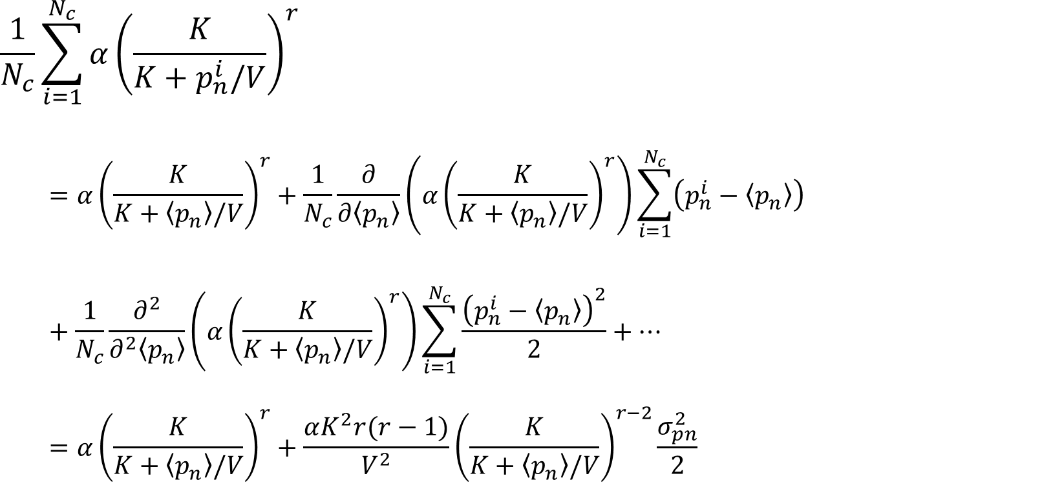
$$\frac{1}{N_{c}}\sum_{i=1}^{N_{c}}{α{\left(\frac{K}{K+p_{n}^{i}/V}\right)}^{r}}$$
$$=α{\left(\frac{K}{K+\left\langle p_{n}\right\rangle /V}\right)}^{r}+\frac{1}{N_{c}}\frac{∂}{∂\left\langle p_{n}\right\rangle }\left(α{\left(\frac{K}{K+\left\langle p_{n}\right\rangle /V}\right)}^{r}\right)\sum_{i=1}^{N_{c}}{\left(p_{n}^{i}−\left\langle p_{n}\right\rangle \right)}+\frac{1}{N_{c}}\frac{∂^{2}}{∂^{2}\left\langle p_{n}\right\rangle }\left(α{\left(\frac{K}{K+\left\langle p_{n}\right\rangle /V}\right)}^{r}\right)\sum_{i=1}^{N_{c}}{\frac{{\left(p_{n}^{i}−\left\langle p_{n}\right\rangle \right)}^{2}}{2}}+…$$
$$=α{\left(\frac{K}{K+\left\langle p_{n}\right\rangle /V}\right)}^{r}+\frac{αK^{2}r(r−1)}{V^{2}}{\left(\frac{K}{K+\left\langle p_{n}\right\rangle /V}\right)}^{r−2}\frac{σ_{pn}^{2}}{2}$$

Slide 33
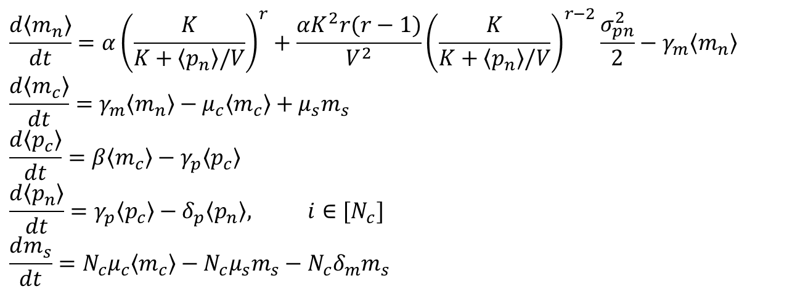
$$\frac{d\left\langle m_{n}\right\rangle }{dt}=α{\left(\frac{K}{K+\left\langle p_{n}\right\rangle /V}\right)}^{r}+\frac{αK^{2}r(r−1)}{V^{2}}{\left(\frac{K}{K+\left\langle p_{n}\right\rangle /V}\right)}^{r−2}\frac{σ_{pn}^{2}}{2}−γ_{m}\left\langle m_{n}\right\rangle$$
$$\frac{d\left\langle m_{c}\right\rangle }{dt}=γ_{m}\left\langle m_{n}\right\rangle −μ_{c}\left\langle m_{c}\right\rangle +μ_{s}m_{s}$$
$$\frac{d\left\langle p_{c}\right\rangle }{dt}=β\left\langle m_{c}\right\rangle −γ_{p}\left\langle p_{c}\right\rangle$$
$$\frac{d\left\langle p_{n}\right\rangle }{dt}=γ_{p}\left\langle p_{c}\right\rangle −δ_{p}\left\langle p_{n}\right\rangle , i∈[N_{c}]$$
$$\frac{dm_{s}}{dt}=N_{c}μ_{c}\left\langle m_{c}\right\rangle −N_{c}μ_{s}m_{s}−N_{c}δ_{m}m_{s}$$

Slide 34
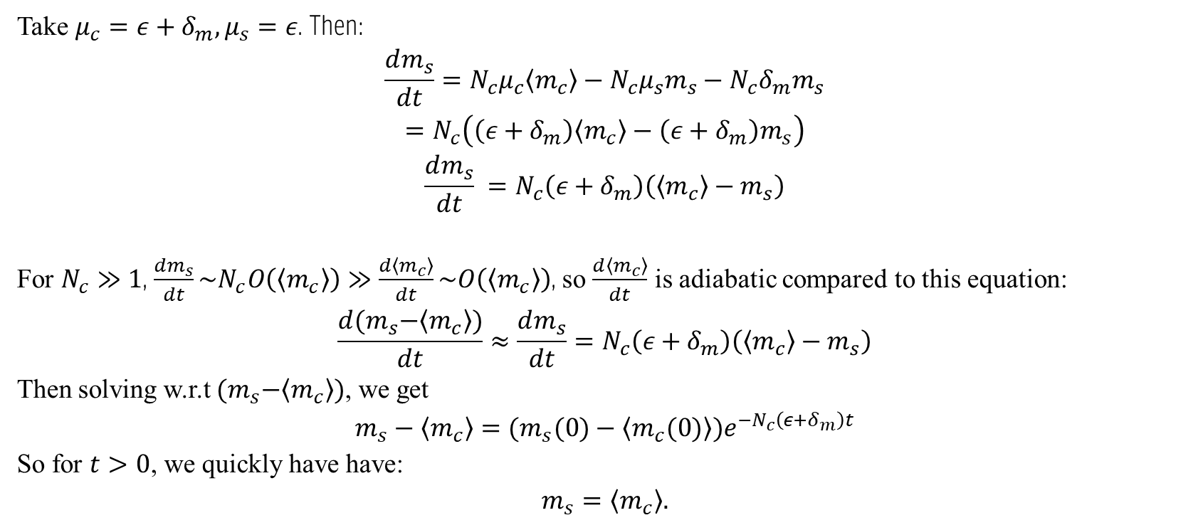
Take $μ_{c}=ε+δ_{m}, μ_{s}=ε$. Then:
$$\frac{dm_{s}}{dt}=N_{c}μ_{c}\left\langle m_{c}\right\rangle −N_{c}μ_{s}m_{s}−N_{c}δ_{m}m_{s}$$
$$=N_{c}\left(\left(ε+δ_{m}\right)\left\langle m_{c}\right\rangle −\left(ε+δ_{m}\right)m_{s}\right)$$
$$\frac{dm_{s}}{dt} =N_{c}\left(ε+δ_{m}\right)\left(\left\langle m_{c}\right\rangle −m_{s}\right)$$
For $N_{c}≫1$, $\frac{dm_{s}}{dt}\sim N_{c}O\left(\left\langle m_{c}\right\rangle \right)≫\frac{d\left\langle m_{c}\right\rangle }{dt}\sim O\left(\left\langle m_{c}\right\rangle \right)$, so $\frac{d\left\langle m_{c}\right\rangle }{dt}$ is adiabatic compared to this equation:
$$\frac{d{(m}_{s}−\left\langle m_{c}\right\rangle )}{dt}≈\frac{dm_{s}}{dt}=N_{c}\left(ε+δ_{m}\right)\left(\left\langle m_{c}\right\rangle −m_{s}\right)$$
Then solving w.r.t ${(m}_{s}−\left\langle m_{c}\right\rangle )$, we get
$$m_{s}−\left\langle m_{c}\right\rangle ={(m}_{s}(0)−\left\langle m_{c}(0)\right\rangle )e^{−N_{c}\left(ε+δ_{m}\right)t}$$
So for $t>0$, we quickly have have:
$$m_{s}=\left\langle m_{c}\right\rangle .$$

Slide 35
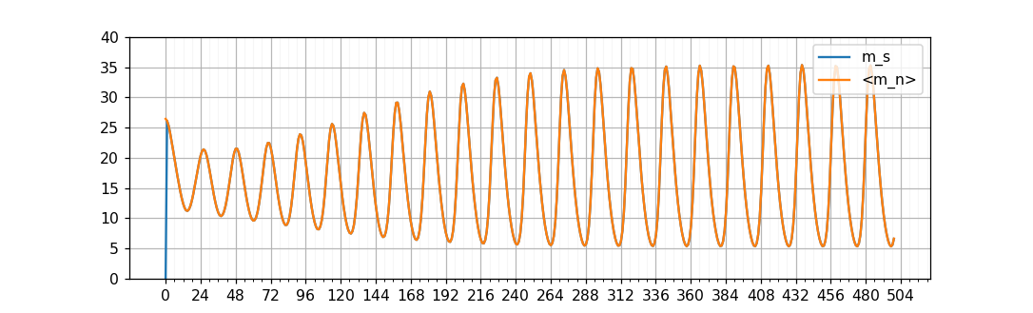
Comparison between $m_{s}$ and $\left\langle m_{c}\right\rangle$ with $N_{c}=100$, $ν=\frac{2π}{22}$, $ε=\frac{2}{22}$.

Slide 36
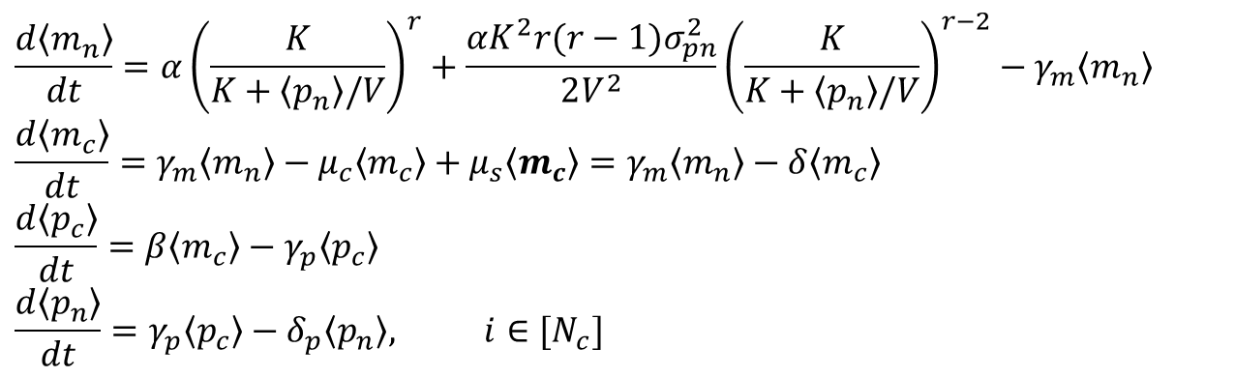

Mean Flow Theory
Plugging back, we get:
Then mean flow critical point for $\left\langle p_{n}\right\rangle$ satisfy:
$α{\left(\frac{K}{K+\left\langle p_{n}\right\rangle /V}\right)}^{r}+$ $\frac{αK^{2}r(r−1)σ_{pn}^{2}}{2V^{2}}{\left(\frac{K}{K+\left\langle p_{n}\right\rangle /V}\right)}^{r−2}$= $δ_{m}δ_{p}\left\langle p_{n}\right\rangle$
Which takes a larger value for larger $σ_{pn}^{2}$.
$λ$ has >0 real part for $σ_{pn}^{2}>0$, which corresponds to growing oscillation amplitude.
$$\frac{d\left\langle m_{n}\right\rangle }{dt}=α{\left(\frac{K}{K+\left\langle p_{n}\right\rangle /V}\right)}^{r}+\frac{αK^{2}r(r−1)σ_{pn}^{2}}{2V^{2}}{\left(\frac{K}{K+\left\langle p_{n}\right\rangle /V}\right)}^{r−2}−γ_{m}\left\langle m_{n}\right\rangle$$
$$\frac{d\left\langle m_{c}\right\rangle }{dt}=γ_{m}\left\langle m_{n}\right\rangle −μ_{c}\left\langle m_{c}\right\rangle +μ_{s}\left\langle m_{c}\right\rangle =γ_{m}\left\langle m_{n}\right\rangle −δ\left\langle m_{c}\right\rangle$$
$$\frac{d\left\langle p_{c}\right\rangle }{dt}=β\left\langle m_{c}\right\rangle −γ_{p}\left\langle p_{c}\right\rangle$$
$$\frac{d\left\langle p_{n}\right\rangle }{dt}=γ_{p}\left\langle p_{c}\right\rangle −δ_{p}\left\langle p_{n}\right\rangle , i∈[N_{c}]$$

Slide 37
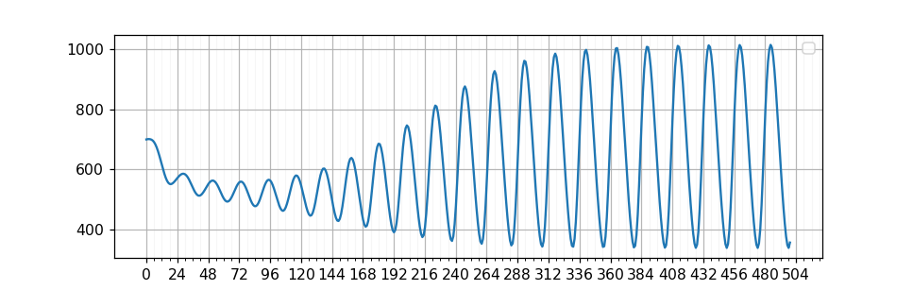

$\left\langle p_{n}\right\rangle$, $N_{c}=100\text{, }ν=\frac{2π}{22}\text{, }ε=\frac{2}{22},V=0.1$

Slide 38
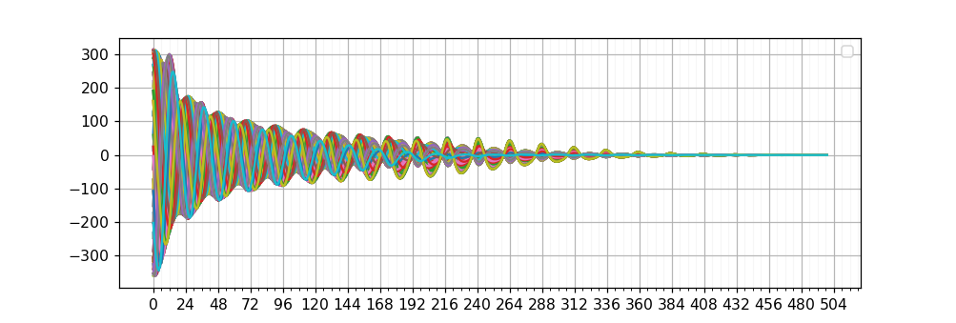
$p_{n}^{i}−\left\langle p_{n}\right\rangle$, $=100\text{, }ν=\frac{2π}{22}\text{, }ε=\frac{2}{22},V=0.1$

Slide 39
Phenomenological theory on phase coherence

Slide 40




$σ_{pn}$ As a measurement for phase coherence
$$\frac{dm_{n}^{i}}{dt}=α{\left(\frac{K}{K+p_{n}^{i}/V}\right)}^{r}−γ_{m}m_{n}^{i}$$
$$\frac{dm_{c}^{i}}{dt}=γ_{m}m_{n}^{i}−μ_{c}m_{c}^{i}+μ_{s}m_{s}=γm_{n}^{i}−δ_{m}m_{c}^{i}+ε(\left\langle m_{c}\right\rangle −m_{c})$$
$$\frac{dp_{c}^{i}}{dt}=βm_{c}^{i}−γ_{p}p_{c}^{i}$$
$$\frac{dp_{n}^{i}}{dt}=γ_{p}p_{c}^{i}−δ_{p}p_{n}^{i}, i∈[N_{c}]$$
Variation of constants:
$⇒m_{c}−\left\langle m_{c}\right\rangle \sim$(${m_{c}}_{0}−{\left\langle m_{c}\right\rangle }_{0}$) $e^{−εt}$
$⇒p_{n}−\left\langle p_{n}\right\rangle \sim$(${p_{n}}_{0}−{\left\langle p_{n}\right\rangle }_{0}$) $e^{−εt}$
$$⇒\sqrt{\left\langle {\left(p_{n}−\left\langle p_{n}\right\rangle \right)}^{2}\right\rangle }\sim {σ_{pn}}_{0}e^{−εt}$$
In reality:
$$σ_{p_{n}}\sim {σ_{pn}}_{0}e^{−0.173εt}$$
$\frac{1}{0.173ε}$ - characteristic duration

Slide 41


$σ_{pn}$ (blue), $N_{c}$ $=100\text{, }ν=\frac{2π}{22}\text{, }ε=\frac{2}{22},V=0.1$
$250e^{−0.173εt}$ (orange)

Slide 42


$σ_{pn}$ (blue), $N_{c}$ $=100\text{, }ν=\frac{2π}{22}\text{, }ε=\frac{3}{20},V=0.1$
$250e^{−0.173εt}$ (orange)

Slide 43


$σ_{pn}$ (blue), $N_{c}$ $=100\text{, }ν=\frac{2π}{22}\text{, }ε=\frac{5}{20},V=0.1$
$250e^{−0.173εt}$ (orange)

Slide 44
Why 0.173?

Slide 45
Conclusion

Slide 46

When exchange rate ~ 1/6 of degradation rate, it takes about 1/0.173*22=127 hrs to recover from jet lag
There is a incoherent phase where one is always sleepy after desynchronization

Slide 47
References
Guanyu Wang and Charles S. Peskin, Phys. Rev. E 97, 062416 – Published 25 June 2018, https://journals.aps.org/pre/abstract/10.1103/PhysRevE.97.062416

